Slide 1
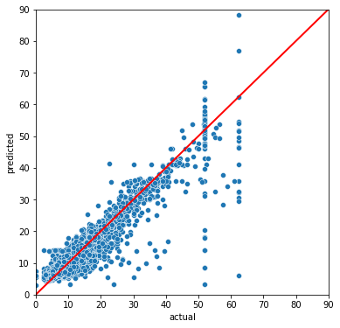
Linear Regression Model for Predicting Taxi Fares
Executive Summary
Project Overview
The goal of this project is to build a multiple linear regression model that is capable of predicting the taxi fare amount based on variables for which data is available.
An EDA was performed to identify what variables could be used for predicting the fare amount.
The trip_distance and duration (tpep_dropoff - tpep_pickup) were identified as potential candidates for predicting the fare amount, alongside a couple of other variables.
From the trip_distance and the duration, the mean values for pairs of pick-up and drop-off locations were computed. A “rush hour” variable was also added to tag trips that occur during rush hour based on the tpep_pickup variable.
The final model used the following predictor variables:
mean_distance
mean_duration
rush_hour
VendorID
After scaling the predictors and fitting the linear model, the R² value of 0.868 was obtained on the test data.
The residuals followed a normal distribution and were scattered randomly, meaning that the modelling assumptions are met.
Scatterplot showing the predicted values versus the actual values for the fare amount.
The scatterplot based on the test data shows that the model predicts the actual fare amounts quite well.
The model needs to be adapted to take into account the fixed fare amount for taxi rides to and from the JFK airport.
The model could also be simplified by being retrained without the VendorID, as it does not provide any predicting power.
The final model can be used to predict fare amounts, given that the mean distance between the pick-up and drop-off locations is known.

